Slide 1
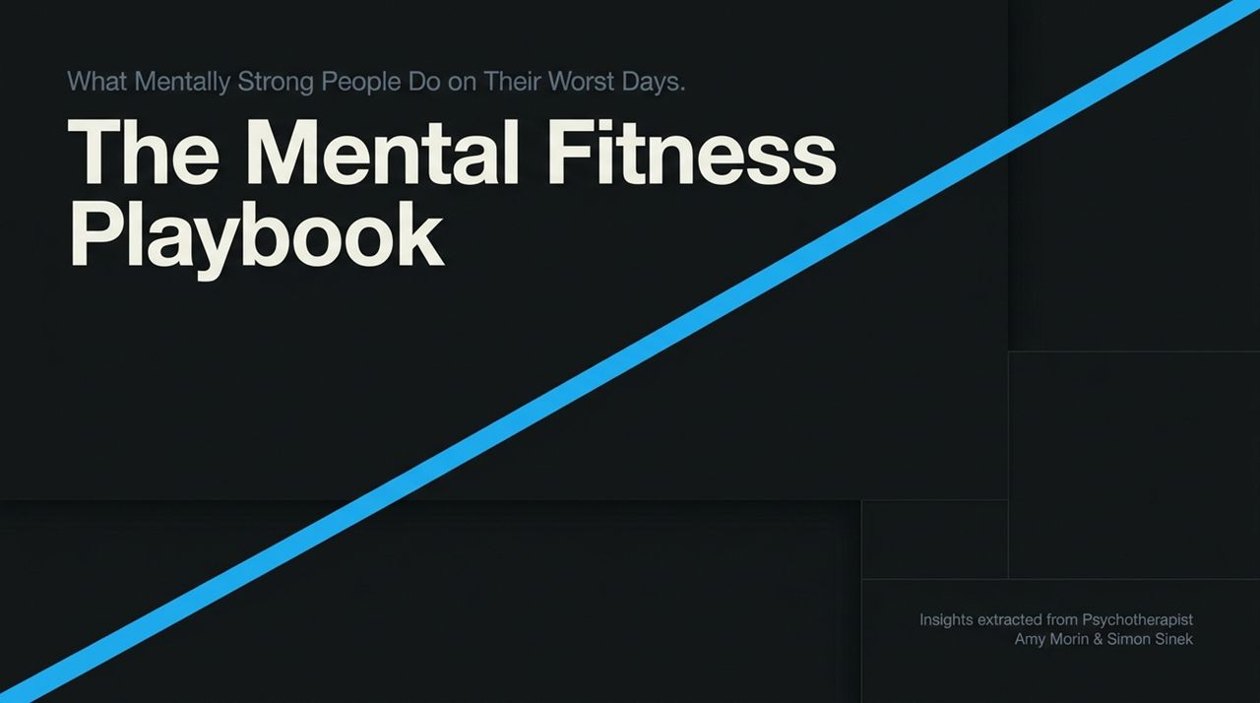
Notes:
Welcome, everyone. Today, we’re stepping away from the generic wellness advice you see online and diving into The Mental Fitness Playbook. The insights we’ll cover come from a conversation between psychotherapist Amy Morin—author of 13 Things Mentally Strong People Don't Do—and Simon Sinek.
Notice the language we are using right away: Mental Fitness, not just mental health. Health is often framed as a static goal—you either have it or you don't. Fitness, on the other hand, is a daily practice. Over the next several slides, we’re going to discuss what mentally strong people actually do on their absolute worst days, how to navigate personal setbacks, and how to build a actionable system for psychological strength.
What Mentally Strong People Do on Their Worst Days | Psychotherapist Amy Morin
https://www.youtube.com/watch?v=TNdrIk18pio

Slide 2
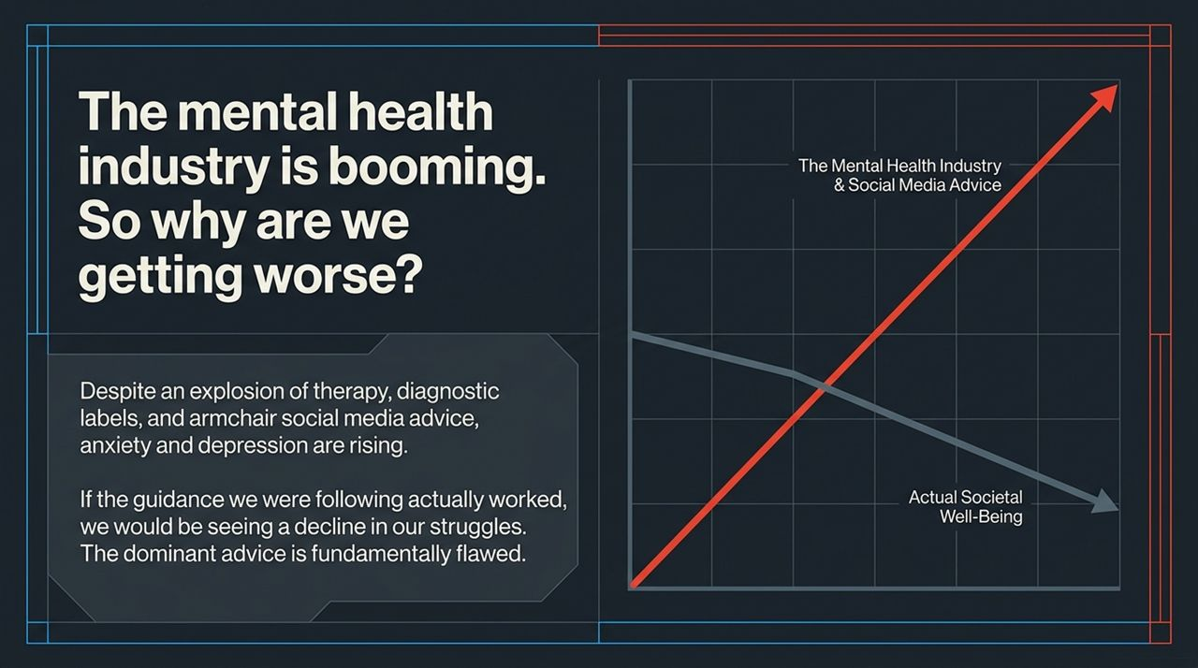
Notes:
Let's start with a glaring paradox in modern society. Look at this graph. The red line represents the booming mental health industry, social media influencers, self-help books, and armchair advice. The gray line shows actual societal well-being.
As Simon Sinek pointed out in his conversation with Amy Morin: If all this mental health advice and constant social media chatter were actually working, shouldn't we see a decline in anxiety and depression? But we don't. Rates of anxiety and depression are climbing. This means the dominant advice we are consuming—or the way we are applying it—is fundamentally flawed. We are obsessing over analyzing past trauma and dissecting our feelings, yet society feels less equipped than ever to handle adversity.

Slide 3
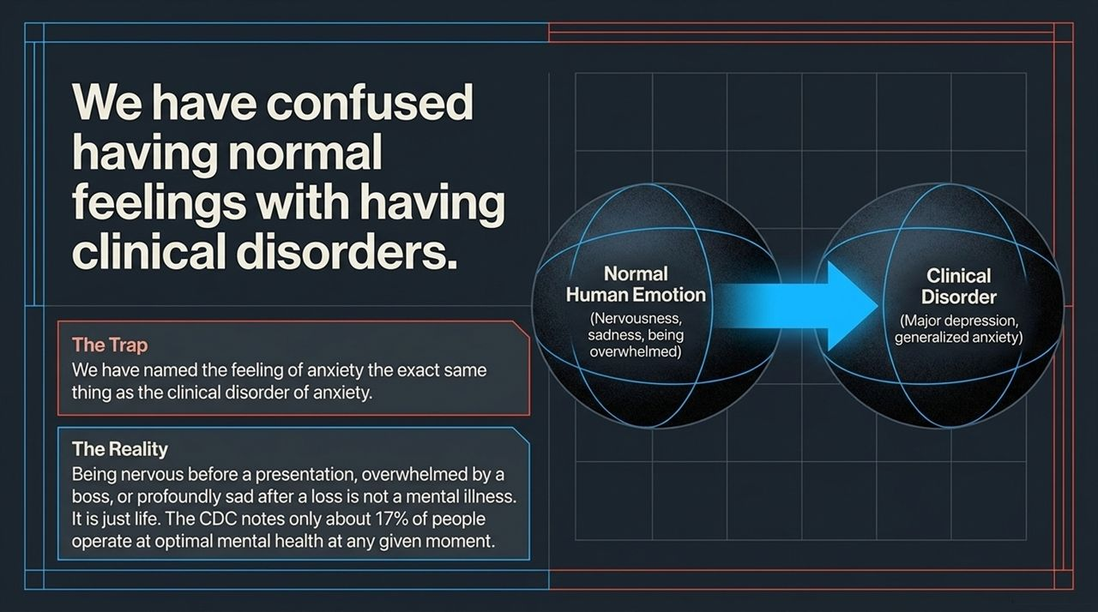
Notes:
Why are we struggling so much? Amy Morin points out a major issue: We have named normal human emotions using the exact same terms as clinical disorders.
When someone feels nervous before a public speech, stressed by a manager, or deeply sad after a loss, social media labels it as 'social anxiety,' 'trauma,' or 'depression'. But being nervous or sad is not a mental illness—it is simply being human.
True clinical disorders—like Major Depressive Disorder or Generalized Anxiety Disorder—are distinct conditions requiring clinical management. The CDC notes that only about 17% of people operate at 'optimal mental health' at any given moment. That leaves 83% of us fluctuating daily based on sleep, diet, stress, and interactions. Having bad days or uncomfortable emotions does not mean you are broken; it means you are experiencing life.

Slide 4
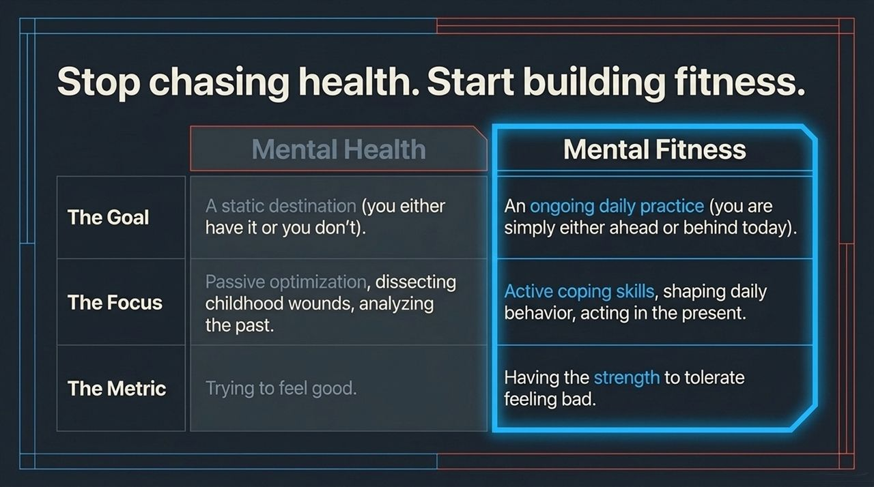
Notes:
This slide outlines a fundamental shift in mindset: stop chasing health as a destination, and start building fitness as a daily practice.
The Goal: Mental Health is often viewed as a static destination—a binary state where you're either 'healthy' or 'ill'. Mental Fitness treats well-being like physical fitness. You are simply either ahead or behind today based on your habits.
The Focus: Traditional therapy advice often focuses on passive analysis—digging up childhood wounds to figure out why you feel bad. Mental Fitness focuses on active coping skills—shaping daily behavior in the present moment.
The Metric: The metric of health is trying to feel good. The metric of fitness is building the capacity to tolerate feeling bad. As Amy Morin notes, when you build the strength to tolerate discomfort, you regain control over your actions.

Slide 5
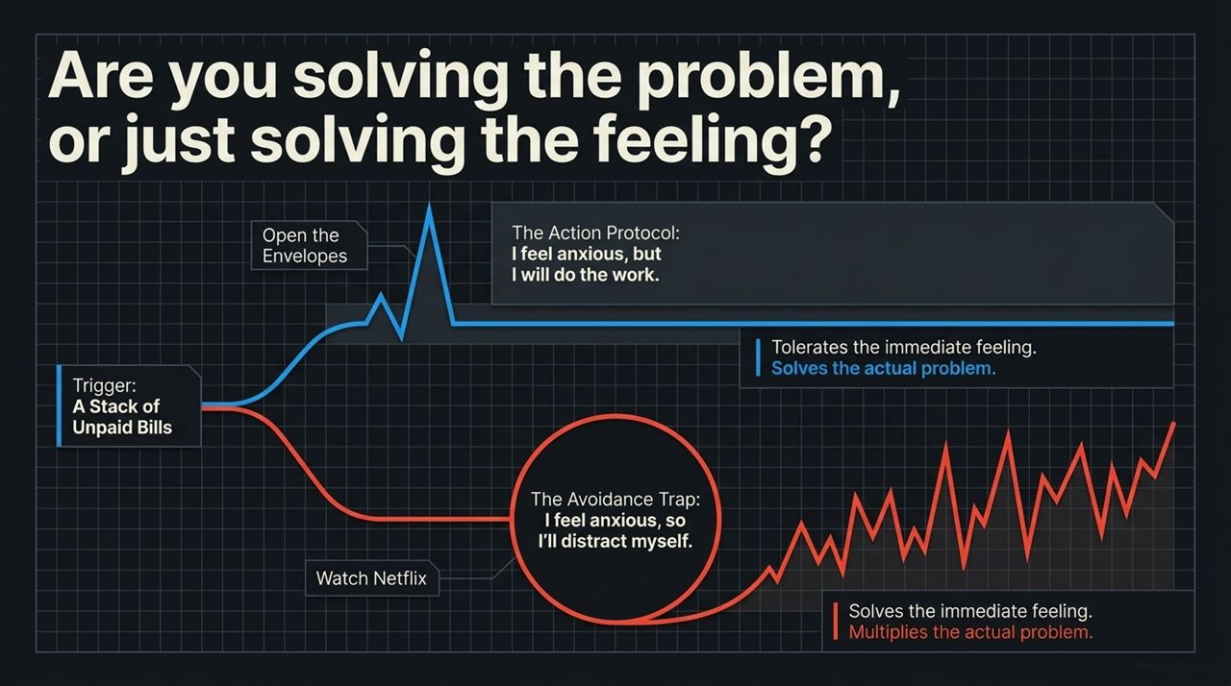
Notes:
When faced with discomfort, what do you usually address first: the problem itself, or how you feel about the problem?
Look at this scenario: The trigger is a stack of unpaid bills on your table. Opening them causes anxiety.
The Avoidance Trap: You say, 'I feel anxious, so I'm going to solve my immediate feeling.' You ignore the bills and binge-watch Netflix. Watching TV temporarily soothes your feeling, but it multiplies the underlying problem. Tomorrow, the bills remain, accompanied by late fees and added stress.
The Action Protocol: You say, 'I feel anxious, but I am going to open the envelopes anyway.' This tolerates immediate discomfort to resolve the actual issue.
Next time you feel overwhelmed, ask yourself: Am I trying to solve the problem, or am I just trying to soothe my feelings?

Slide 6
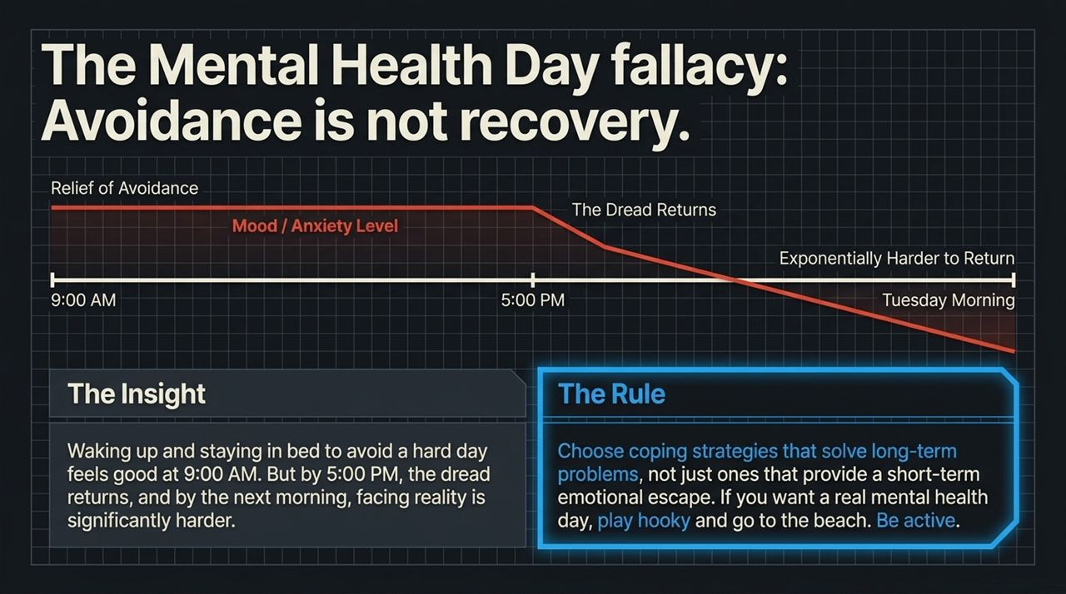
Notes:
Let's examine a common wellness habit: taking a 'mental health day' by staying in bed.
Imagine waking up feeling overwhelmed by work. At 9:00 AM, deciding to stay in bed under the covers provides instant relief. But what happens by 5:00 PM? The dread returns because the workload and unaddressed tasks are still waiting. By Tuesday morning, facing reality is twice as hard. Avoidance is not recovery; it is delay.
The Rule: Choose coping strategies that solve long-term problems, not just short-term emotional escapes. If you need a true break, go play hooky at the beach or do an active hobby that changes your state. Don't confuse staying in bed to avoid life with genuine mental recovery.

Slide 7
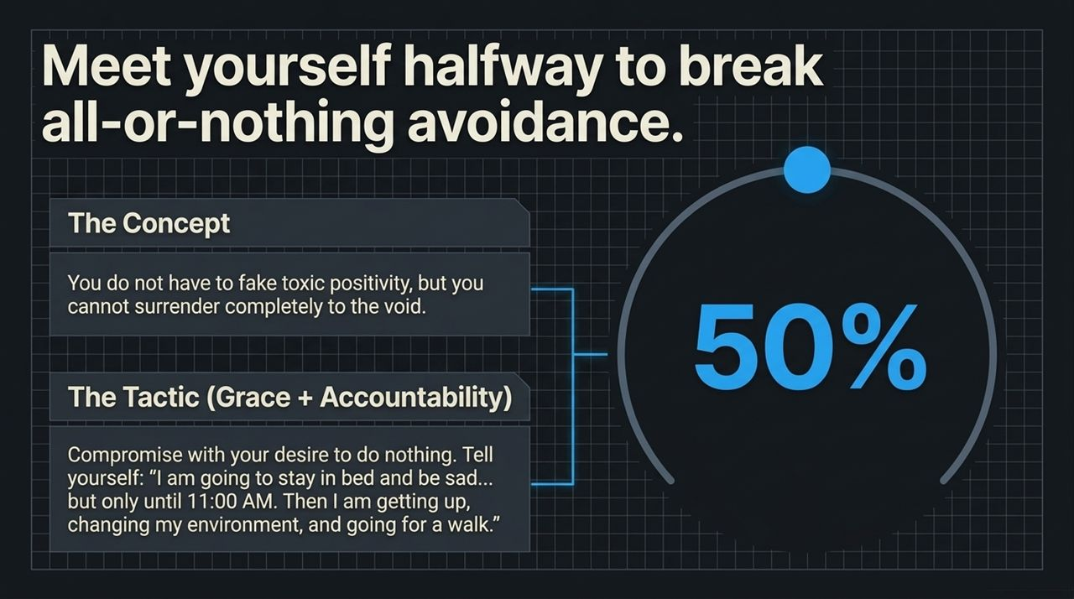
Notes:
How do we bridge the gap between needing rest and falling into an avoidance trap? We meet ourselves halfway using a combination of Grace and Accountability.
You don't have to force toxic positivity or pretend everything is fine. But you also shouldn't completely surrender to inaction.
The Tactic: Strike a compromise with your urge to withdraw. Say to yourself: 'I am going to stay in bed and feel sad... but only until 11:00 AM. At 11:00 AM, I am getting up, changing my clothes, and going for a walk.' This grants yourself grace to process emotions while enforcing a firm boundary against total collapse.

Slide 8
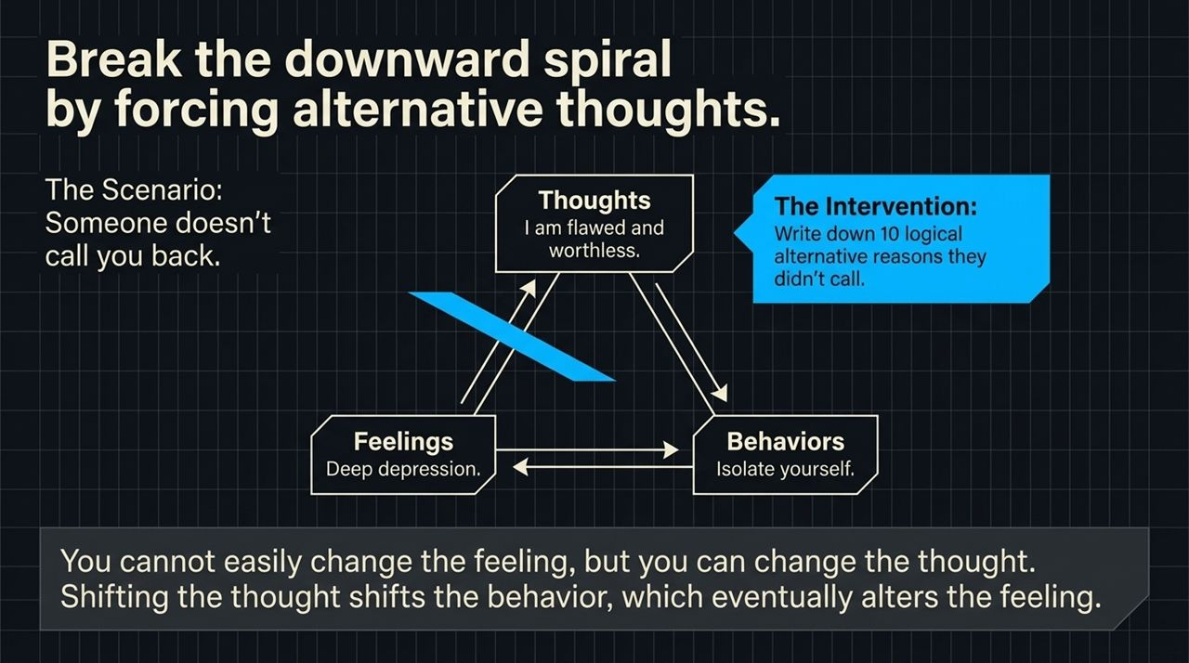
Notes:
Amy Morin is a trained Cognitive Behavioral Therapist (CBT). CBT relies on the connection between Thoughts, Feelings, and Behaviors.
Consider this scenario: Someone doesn't return your phone call.
Thought: Your brain jumps to, 'They dislike me because I am flawed and worthless.'
Feeling: That thought triggers feelings of rejection and depression.
Behavior: You withdraw, isolate yourself, and refuse to reach out to anyone else.
The Intervention: It is extremely difficult to force a feeling to change directly. However, you can challenge the underlying thought. Force yourself to write down 10 logical alternative reasons why they didn't call—their phone died, they were in a meeting, or they got busy. Shifting the thought breaks the spiral, alters your behavior, and lifts your mood.

Slide 9
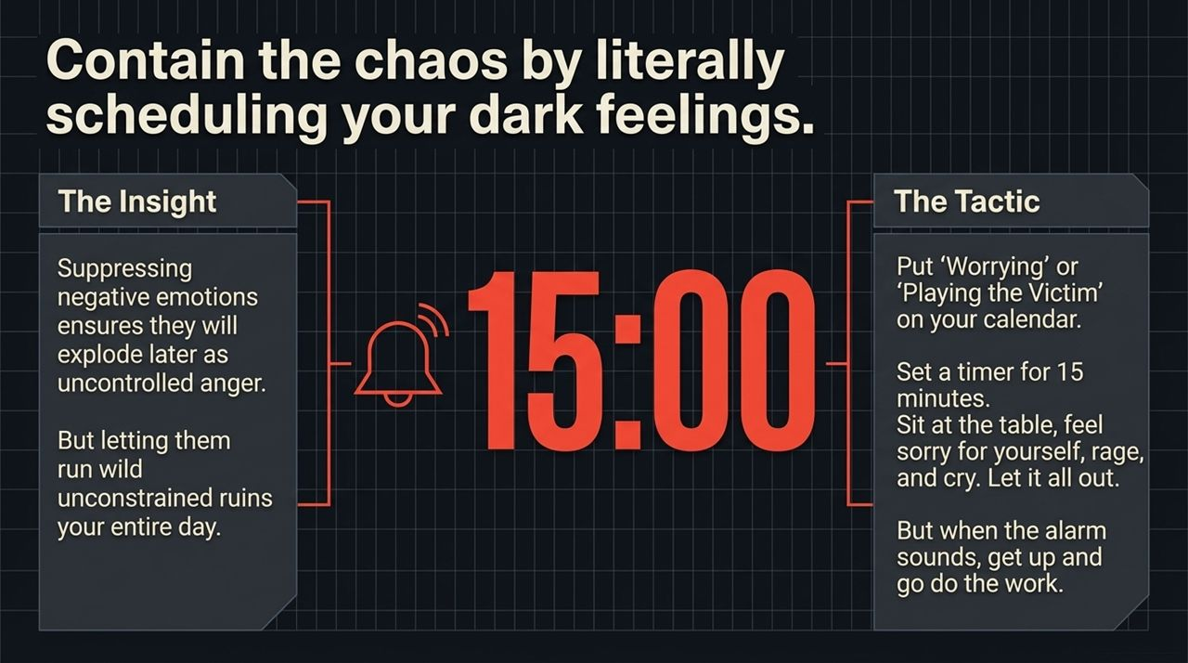
Notes:
Suppressing bad feelings makes them explode later as uncontrolled irritability. But letting negative feelings run wild all day ruins your productivity. The solution is to schedule your worry time.
Research shows that setting aside 15 minutes a day for designated worrying significantly reduces baseline anxiety.
The Protocol:
Schedule a 15-minute block on your calendar titled 'Worrying' or 'Self-Pity'.
When the alarm goes off, sit down at your table and allow yourself to rage, cry, worry, or play the victim. Let it all out.
When the 15-minute timer rings, get up, wash your face, and move on to your next task. If worries pop up during the day, tell yourself: 'Not right now; I will handle that during my scheduled worry time at 7:00 PM.'

Slide 10
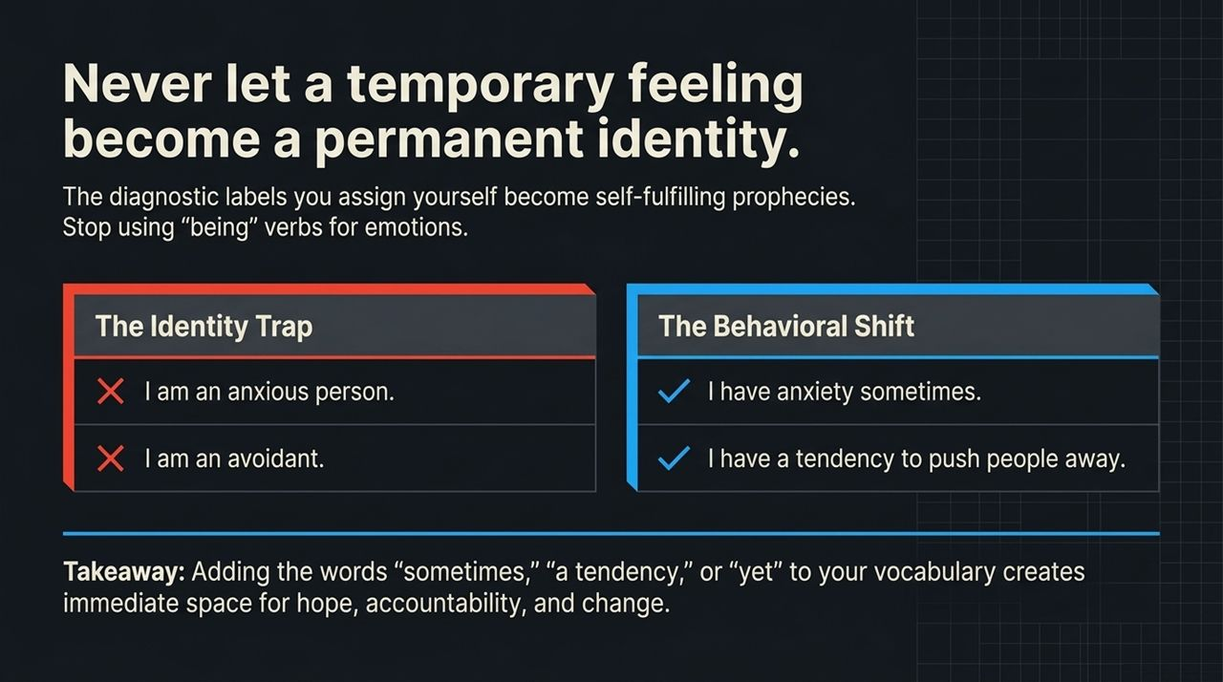
Notes:
Words shape reality. One of the most subtle traps in modern mental health discourse is turning temporary state feelings into permanent identities.
Look at these shifts:
Instead of saying, 'I am an anxious person,' shift to 'I have anxiety sometimes.'
Instead of saying, 'I am an avoidant,' shift to 'I have a tendency to push people away.'
Notice the language: 'I am' creates an unchangeable identity trait. Using qualifiers like 'sometimes,' 'a tendency,' or adding the word 'yet' ('I haven't learned this yet') leaves room for hope, agency, and behavioral change.

Slide 11
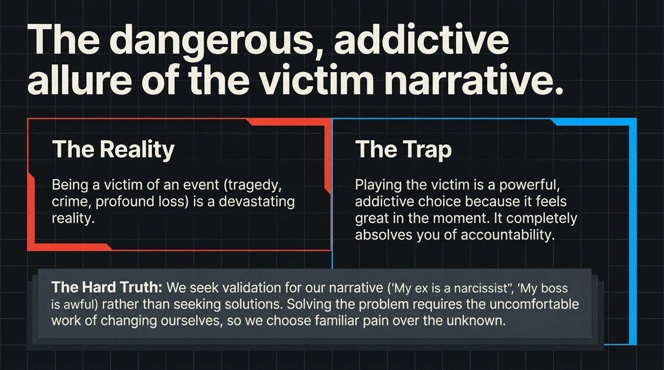
Notes:
We need to discuss a sensitive subject: the difference between being a victim and playing the victim.
Being a victim of a terrible event—a loss, crime, or tragedy—is a devastating reality.
Playing the victim, however, is a psychological choice that can become addictive. It provides instant emotional validation and frees you from personal accountability.
It feels comfortable to tell friends, 'My ex was a narcissist' or 'My boss is horrible,' because it shifts 100% of the fault away from us. But as Amy Morin points out, seeking validation for a victim narrative keeps you stuck. Solving problems requires taking responsibility for our choices, which is why people often choose familiar pain over the uncertainty of real change.

Slide 12
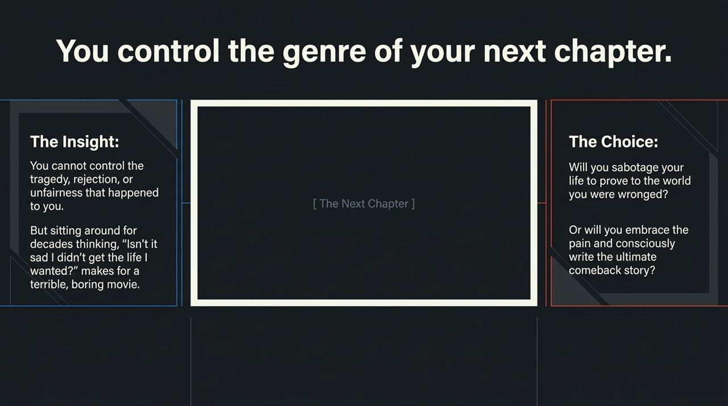
Notes:
You cannot control the tragedies, rejections, or unfair circumstances that happen to you. But you have control over the narrative you write next.
Imagine your life as a movie. If the main character spends 40 years sitting in a room thinking, 'Isn't it sad that my life didn't turn out how I wanted?'—that makes for a slow, uninspiring film.
You face a fundamental choice:
Will you sabotage your future to prove to the world that you were wronged?
Or will you embrace the pain, take control of your actions, and write a compelling comeback story?
A comeback story doesn't mean pretending the tragedy didn't happen. It means deciding that the tragedy is the middle of your story, not the end.

Slide 13
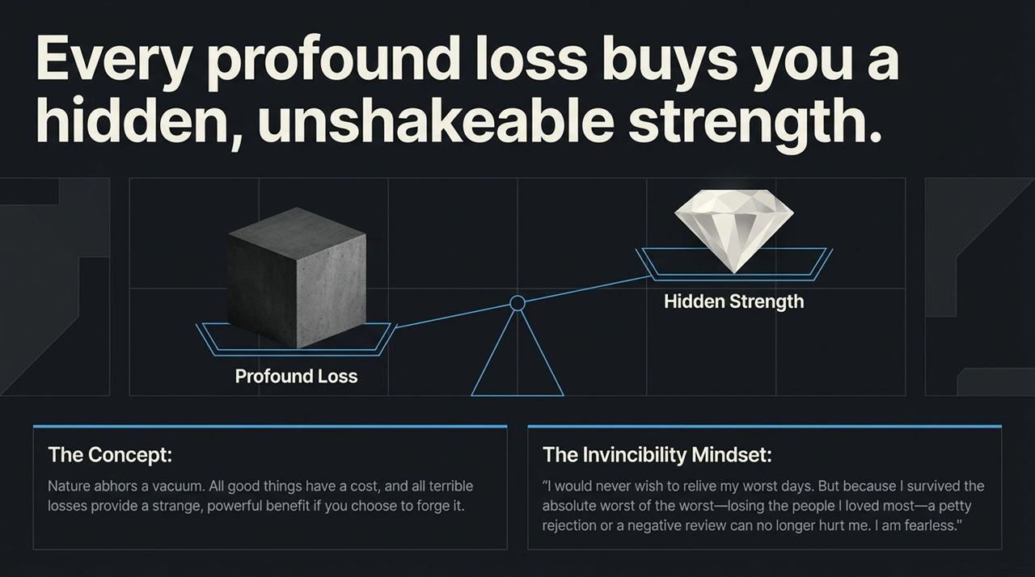
Notes:
Nature abhors a vacuum. Every severe trial brings a hidden, unshakeable strength if you actively choose to forge it.
Amy Morin shares a powerful personal story on this topic. At age 23, she lost her mother to a brain aneurysm. Three years later, her 26-year-old husband passed away unexpectedly from a heart attack. Years later, her father-in-law was diagnosed with terminal cancer.
She notes that while she would never want to relive those devastating days, surviving them created an invincibility mindset. Giving the eulogy at her husband's funeral eliminated her former fear of public speaking. As she put it: 'I have survived the absolute worst moments of my life. A negative review or petty rejection can no longer crush me.' When you survive your worst days, everyday anxieties lose their power over you.

Slide 14
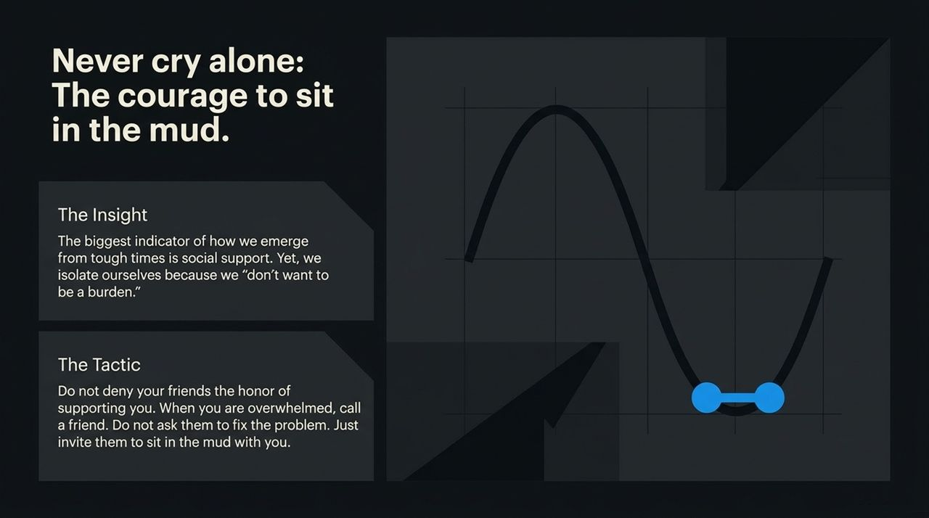
Notes:
Social support is the single greatest predictor of how well someone recovers from adversity. Yet, when people struggle, their default response is often isolation because they 'don't want to be a burden.'
Simon Sinek shares a simple rule he lives by: No crying alone.
When you are overwhelmed, call a close friend. You don't need them to fix your problem or give unsolicited advice. Simply ask them to 'sit in the mud' with you. Reaching out isn't burdening your friends; it grants them the privilege of being there for you when it matters most.

Slide 15
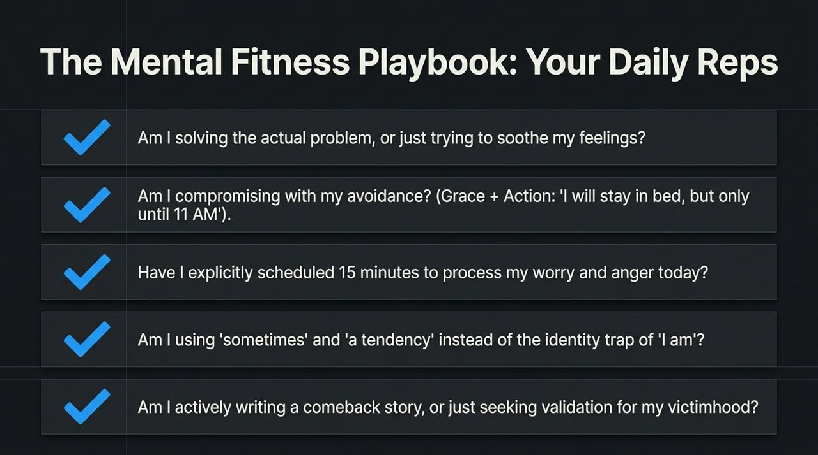
Notes:
To build mental strength, view these principles as daily exercise reps. Here is your self-reflection checklist to review when facing a difficult day:
Problem vs. Feeling: Am I solving the actual problem, or am I just trying to soothe my temporary feelings?
Grace + Action: Am I compromising with my avoidance? ('I will rest, but I get up at 11:00 AM')
Worry Time: Have I scheduled my 15 minutes to process worry and anger, or am I letting it leak into my entire day?
Language Shift: Am I using 'sometimes' and 'a tendency' instead of trap labels like 'I am an anxious person'?
Narrative Ownership: Am I actively writing a comeback story, or am I just seeking validation for being a victim?

Slide 16
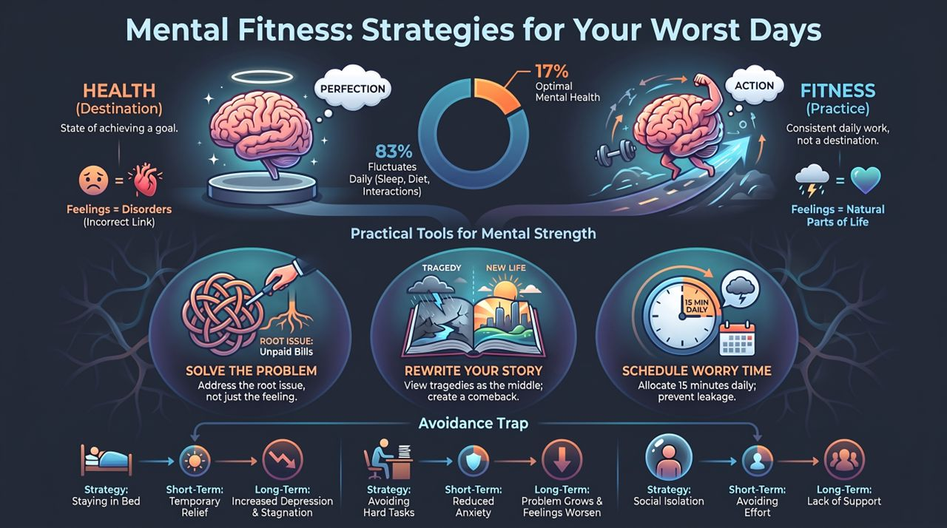
Notes:
To conclude, here is the full blueprint of the Mental Fitness Framework:
Mindset Shift: Move away from treating mental health as a static goal. Treat mental fitness as an ongoing practice that fluctuates based on daily habits.
Solve the Problem: Focus on addressing the root issue (like opening unpaid bills) rather than relying on short-term avoidance (like hiding under the covers).
Schedule Worry: Limit negative rumination to a dedicated 15-minute daily block to protect the rest of your day.
Rewrite Your Story: Reframe life's setbacks not as the end of your journey, but as the middle chapter of a comeback story.
Build Connection: Avoid isolating yourself during tough times—invite trusted people to support you.
Thank you for your time. Let's put these daily reps into practice.
What Mentally Strong People Do on Their Worst Days | Psychotherapist Amy Morin
https://www.youtube.com/watch?v=TNdrIk18pio

